Slide 1
AIR CONDITIONING · CHAPTER 1
1.4 Main Equipment
1
2
Compressors, condensers, expansion devices, AHU and FCU
1.4
The same refrigeration cycle becomes different equipment choices in real buildings.
Compressor
Condenser
3
4
Expansion
AHU/FCU
Concept-first slides with teaching detail in the card
Air Conditioning · Chapter 1 · Topic 1.4
1

Slide 2
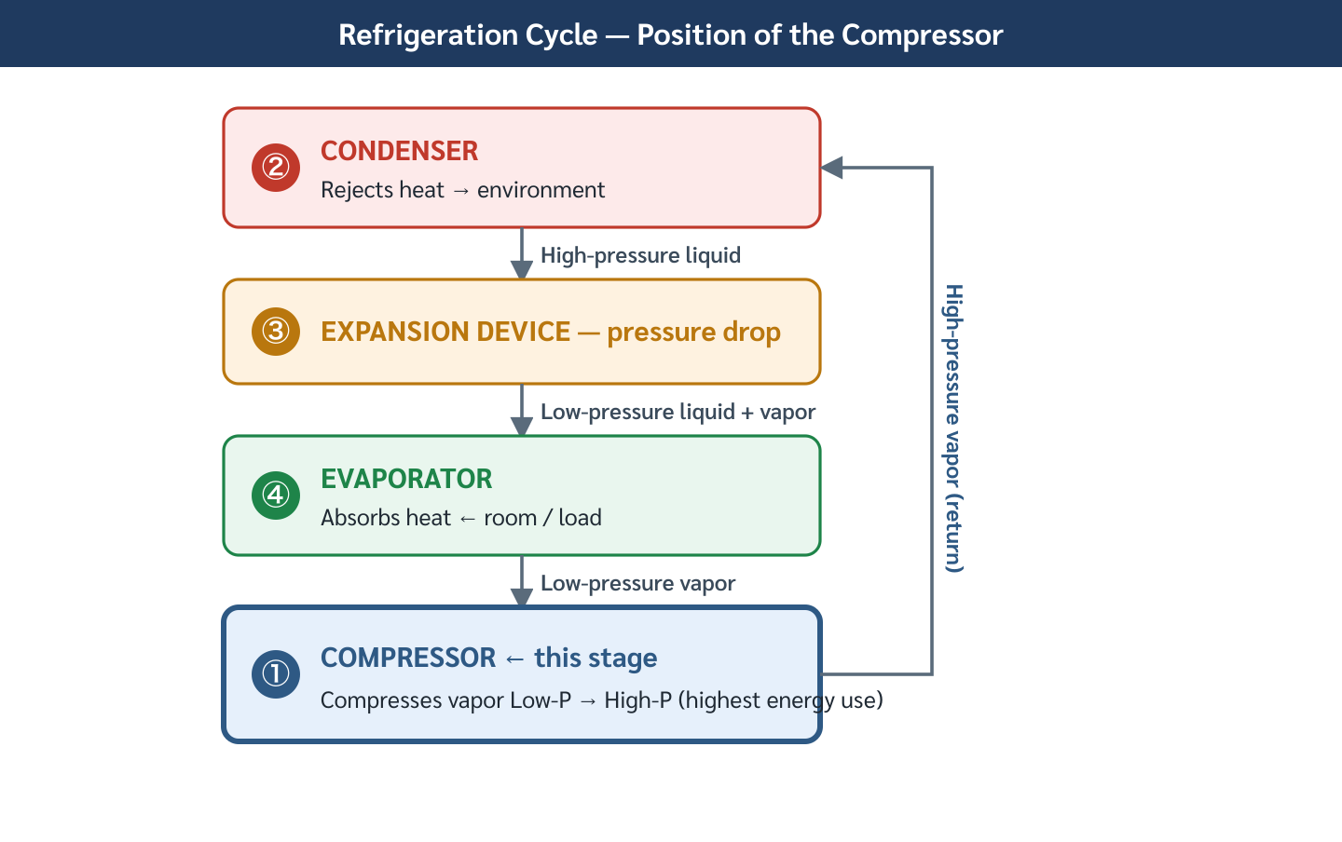
Equipment follows the same four functions
2
Names change, but the thermodynamic jobs remain the same.
EQUIPMENT MAP
Match hardware to the cycle job
Pressure rise
1
compressor family
Heat rejection
2
condenser type
Metering
3
expansion device
Main equipment groups
Air Conditioning · Chapter 1 · Topic 1.4
2

Slide 3
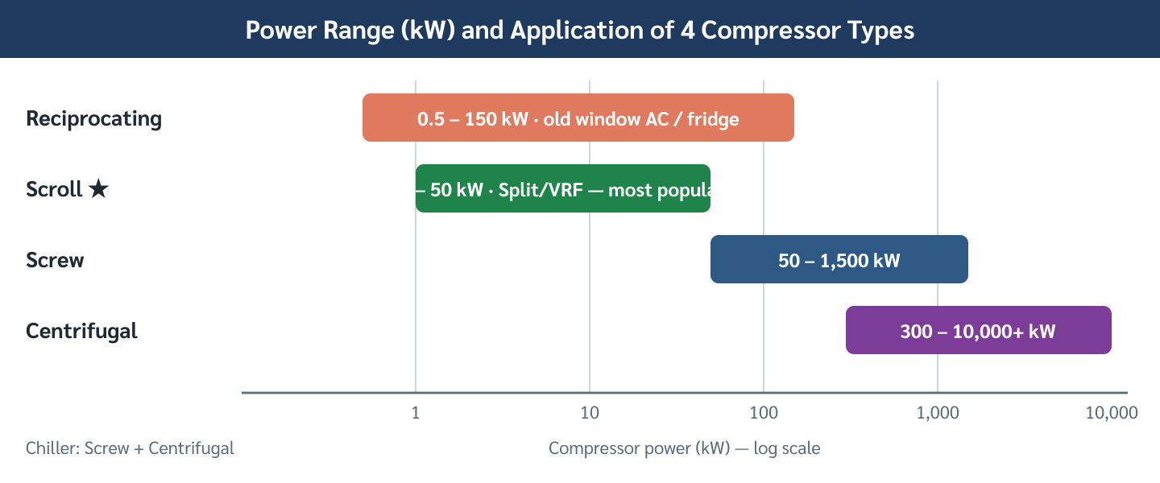
Compressor type follows capacity and load profile
3
Do not select compressor type from capacity alone.
COMPRESSOR CHOICE
Small rooms and large plants need different machines
Reciprocating
1
small, simple, serviceable
Scroll
2
quiet residential/light commercial
Screw
3
medium-large; strong part-load
Compressor type comparison
Air Conditioning · Chapter 1 · Topic 1.4
3

Slide 4
Compressor selection: quick screening language
4
Use this slide to narrate a design decision
Reciprocating
Scroll
Screw
1
2
3
cheap, simple; vibration/noise trade-off
few moving parts; common in split/VRF
reliable for mid-large chillers and variable load
Centrifugal
Hotel case
District cooling
4
5
6
excellent for large steady loads; watch surge
part-load operation favors screw
large steady load favors centrifugal
Air Conditioning · Chapter 1 · Topic 1.4
4

Slide 5
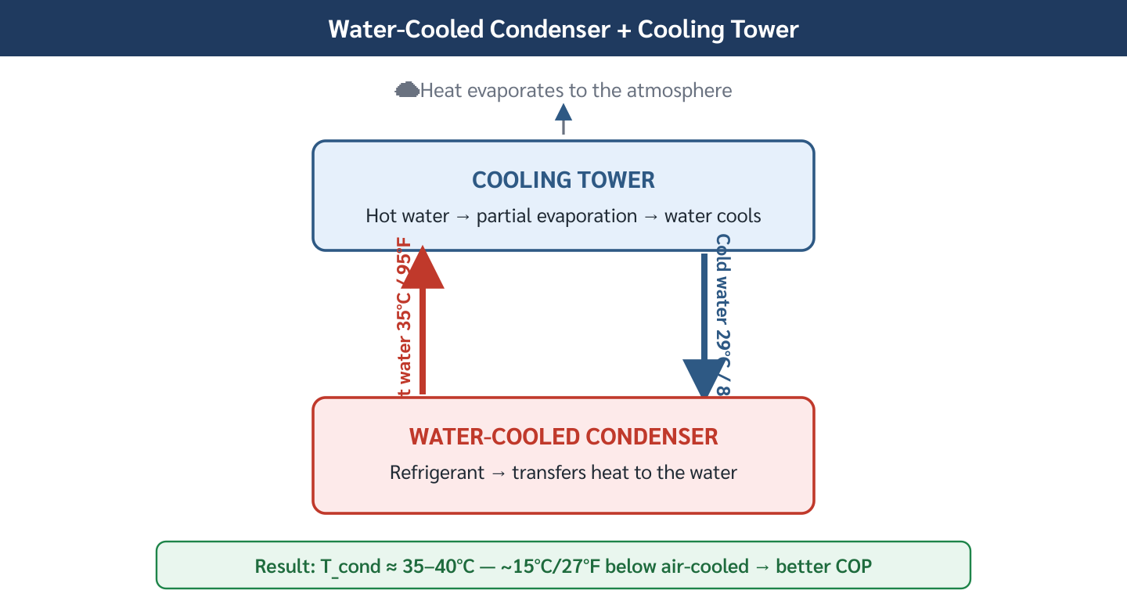
Condenser type controls the heat sink
5
Lower condensing temperature generally improves COP.
HEAT REJECTION
The condenser decides how heat leaves the building
Air-cooled
1
simple; hotter on hot days
Water-cooled
2
lower condensing temperature
Evaporative
3
approaches wet-bulb temperature
Condensing temperature comparison
Air Conditioning · Chapter 1 · Topic 1.4
5

Slide 6
Air-cooled vs water-cooled is a life-cycle decision
6
First cost and operating cost point in different directions
Air-cooled strength
Air-cooled weakness
Water-cooled strength
1
2
3
no tower, pump, or water treatment
COP falls during hot outdoor conditions
often 20–40% more efficient at scale
Water-cooled weakness
Thailand note
4
5
maintenance, water, and plant complexity
hot climate increases value of lower condensing temp
Air Conditioning · Chapter 1 · Topic 1.4
6

Slide 7
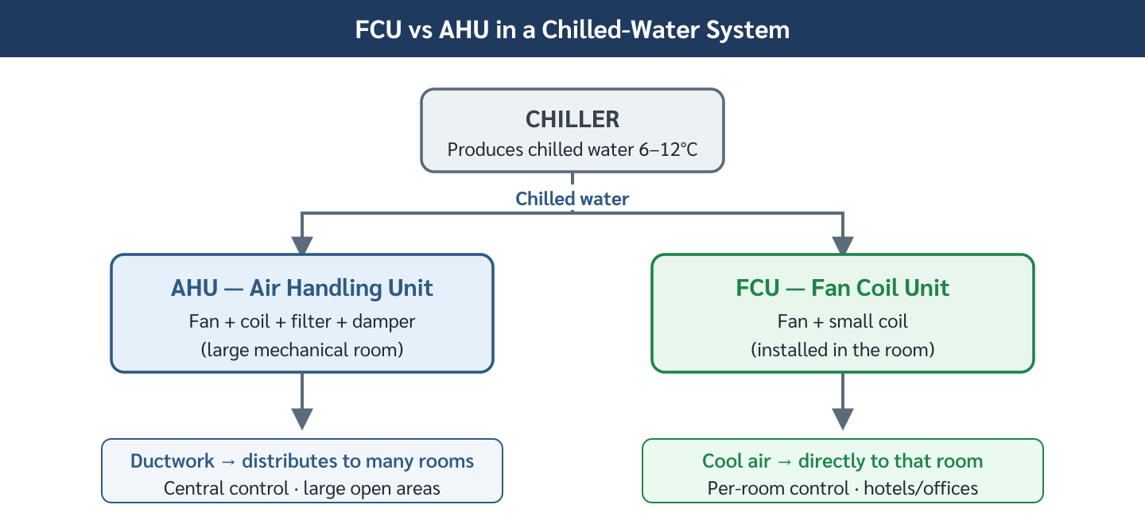
Expansion devices control refrigerant feed
7
The device must fill the evaporator without flooding the compressor.
METERING DEVICE
Control precision affects efficiency and reliability
Capillary tube
1
fixed, cheap, charge-sensitive
TXV
2
mechanical superheat control
EEV
3
fast, precise, inverter/VRF friendly
Expansion device comparison
Air Conditioning · Chapter 1 · Topic 1.4
7

Slide 8
TXV superheat is a teaching bridge to maintenance
8
One setting explains capacity and compressor protection
Too low
Correct range
Too high
1
2
3
wet vapor/liquid risk
evaporator full but compressor dry
starved evaporator; less capacity
Field checks
4
charge, airflow, bulb position, valve response
Air Conditioning · Chapter 1 · Topic 1.4
8

Slide 9
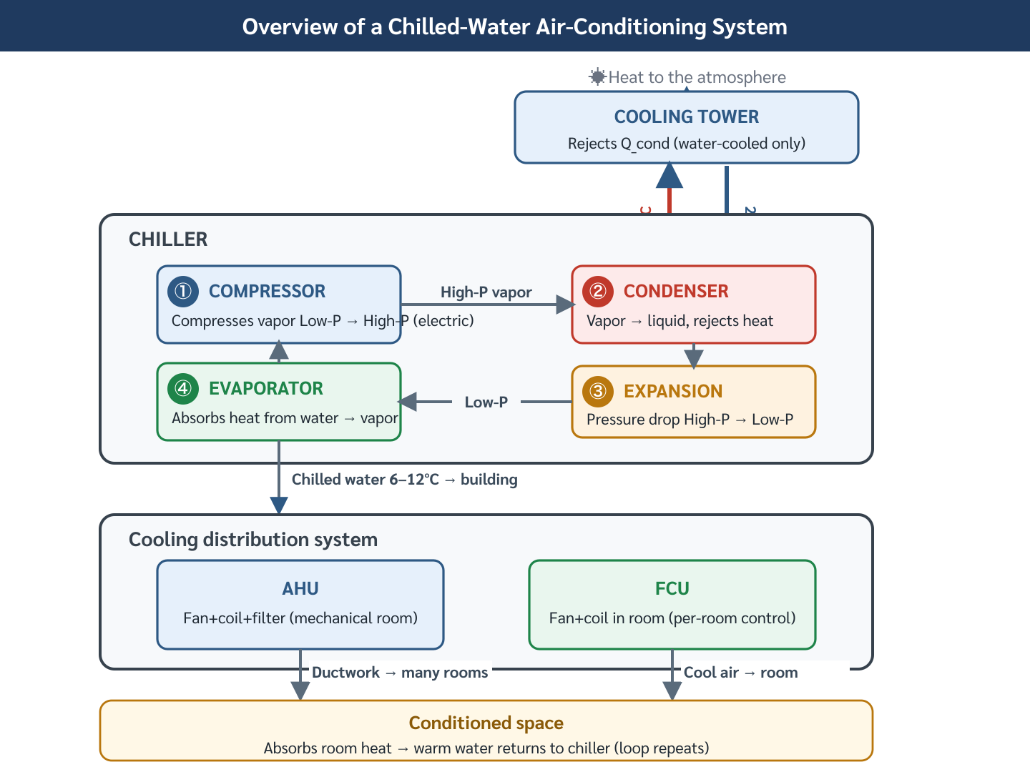
AHU and FCU solve different air-distribution problems
9
Central air handling and room-by-room control are not interchangeable.
AIR SIDE
Choose distribution based on zone strategy
AHU
1
large zones, ducts, filtration, fresh air
FCU
2
small zones, individual room control
Fresh air
3
often needs AHU/DOAS coordination
AHU vs FCU strategies
Air Conditioning · Chapter 1 · Topic 1.4
9

Slide 10
Pause question: choose equipment for a hospital
10
Quiet operation, reliability, filtration, and 24/7 service matter
Compressor
Condenser
Air side
1
2
3
redundant chillers rather than one small unit
water-cooled if lifecycle energy supports it
AHU for filtration and fresh air control
Maintenance
4
access and monitoring are design requirements
Air Conditioning · Chapter 1 · Topic 1.4
10

Slide 11
Topic 1.4 — what students should remember
11
1
2
3
Equipment maps to cycle functions
Selection is contextual
Air-side design shapes use
each machine has a thermodynamic job
capacity, part-load, first cost, efficiency, maintenance
AHU for central control; FCU for distributed rooms
Air Conditioning · Chapter 1 · Topic 1.4
11

